Slide 1
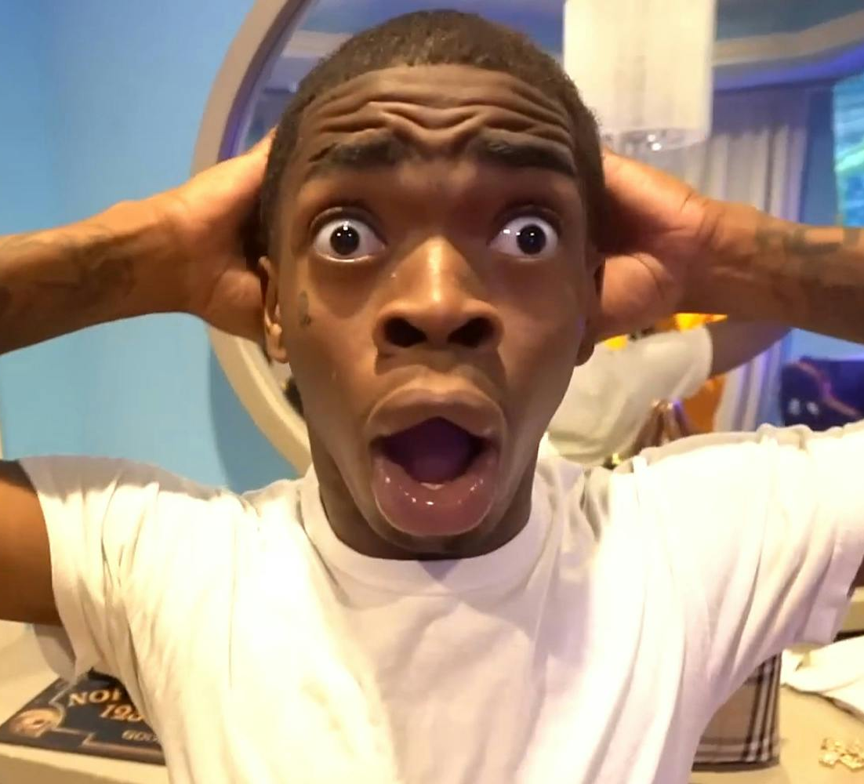
Fold your stroller
By Ho Yin Hei & Li Pak hin

Slide 2

The lives of people with physical impairment
.

Slide 3
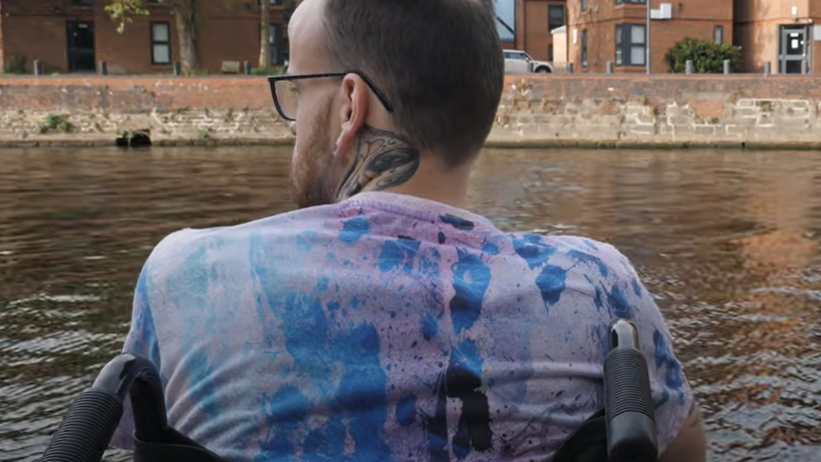
Feeling different
Cannot do activities same as other people
Cannot play normally with other children
Have difficulties in their daily lives
Hard to find a relationship
Being a target of bullies since they can't fight back
Realisation of their disability is very possibly unchangable
2:24-3:00
https://www.youtube.com/watch?v=5dKqpqdZuCs&t=144s

Slide 4

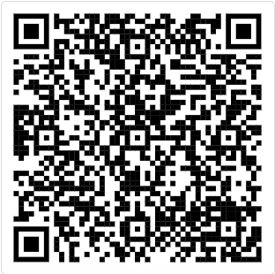
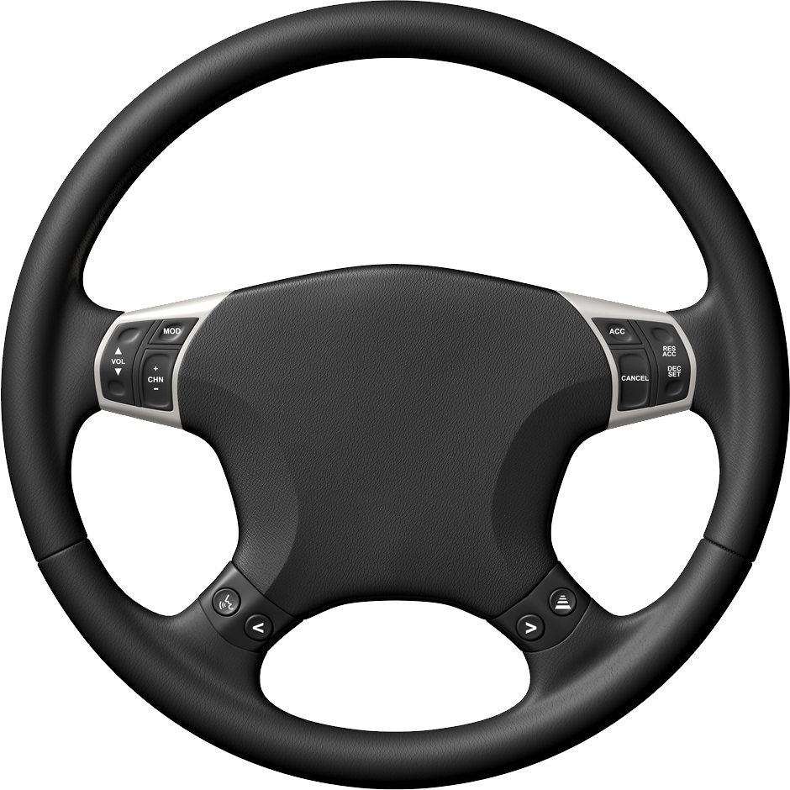
Background information about Mr Luk's daughter
Mr Luk's four-year-old daughter has physical impairment. When they get on a bus. The bus driver asked them to fold the stroller. Also made offensive remarks about Mr Luk's daughter. After that, they tried to complain to the bus company. However, the bus company said that passengers wouldn't have to fold the stroller upon presenting a "Registration Card for people with Disabilities"(aka RC) issued by the Government for their child who had disability. The bus company also undertook to provide relevant guidelines for all drivers.
(Not a rickroll fr)

Slide 5

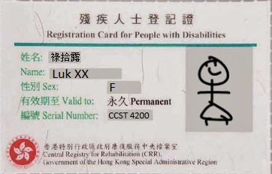
The main case summary
On a rainy day a few months later, they were trying to get on a bus
The bus driver only opened half of the door and signalled to Mrs Luk that she had to fold the stroller.
When she show her daughter’s RC, she told him that the bus company stated the rule could be relaxed under such circumstances.
The driver still insisted and said he had never been informed of the policy
Then he drove away and caused them to be late for school.

Slide 6
Ethical issues related to the case
Disability right
Discrimination
Lack of training and awareness

Slide 7
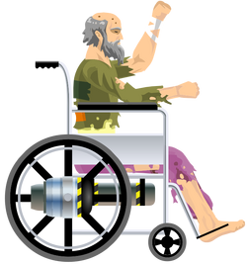
Disability's rights
The bus driver refuse to help Mrs. Luk and her daughter, even when they've shown the registration card.
Highlights a lack of understanding and respect for disability rights.

Slide 8
Discrimination
That one time in the past when they tried to get on a bus, the driver not only asked them to fold the stroller, but also made offensive remarks about their daughter.
-Disrespect her
-Reinforce negative views about people with disabilities.
-May cause emotional pain for the family.
-They may feel judged or unsupported in public, making them feel isolated and unwelcome.

Slide 9
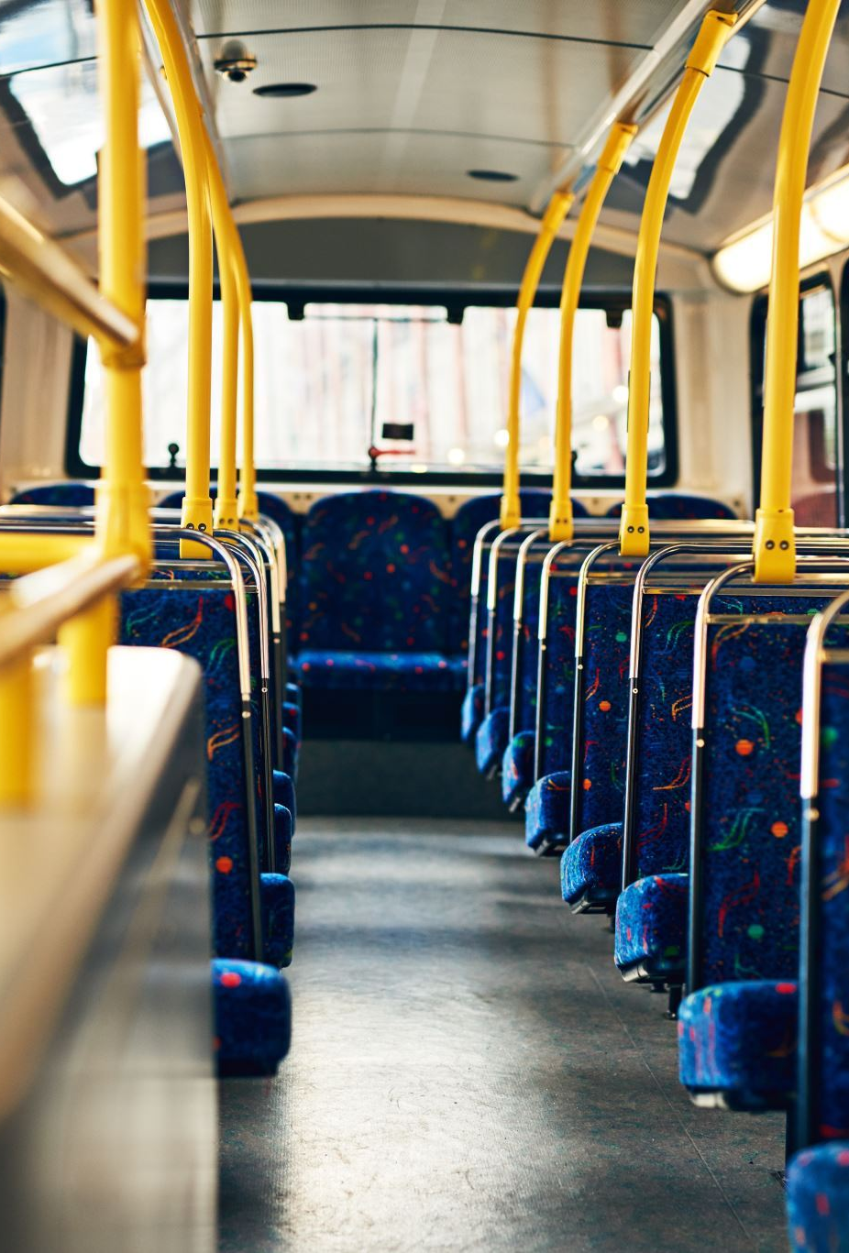
Lack of training and awareness
The bus driver's lack of knowledge about the policy regarding strollers for disabled passengers.
Lack of clear communication between the bus company and its drivers
The bus company cannot ensure that all parties understand regulations and rights.
Effective communication is essential for preventing misunderstandings and ensuring fair treatment.

Slide 10


Cause of discrimination
Why will people think Mr Luk's daughter is different?
-Negative Attitudes and Stereotypes
-Ignorance and lack of education
-Fear and insecurity

Slide 11




What did EOC do
-Relexed the rule, makes the RC is not a necessary condition.
-Spread the message about Mr Luk's daughter to the public through their official website and social media platforms.
-Communicate with civil society groups to further communicate the policy to parents and others in need.

Slide 12
Effectiveness of their actions
Relaxing the rule:
-only issue a staff circular to state the rules actually contributes nothing to the situation
Spread the message to the public:
-cannot help solve their current situation or whatsoever
Communicate with civil society groups:
-still cannot solve their current problems
-but can help prevent similar problems occuring in the future
Conclusion Ineffective

Slide 13
Definition of utilitarianism
-Promote the greatest happiness to the greatest amount of people
-Concentrate on the consequences of an incident
-If the consequence is good, the action is good (moral).

Slide 14
Utilitarianism (moral?)
Mr Luk's daughter being late at school because the bus driver need them to fold the stroller
Mr Luk's daughter is sad
There is no benefit for the bus driver and passengers
There is no one happy or have advantage
So,it is immoral

Slide 15

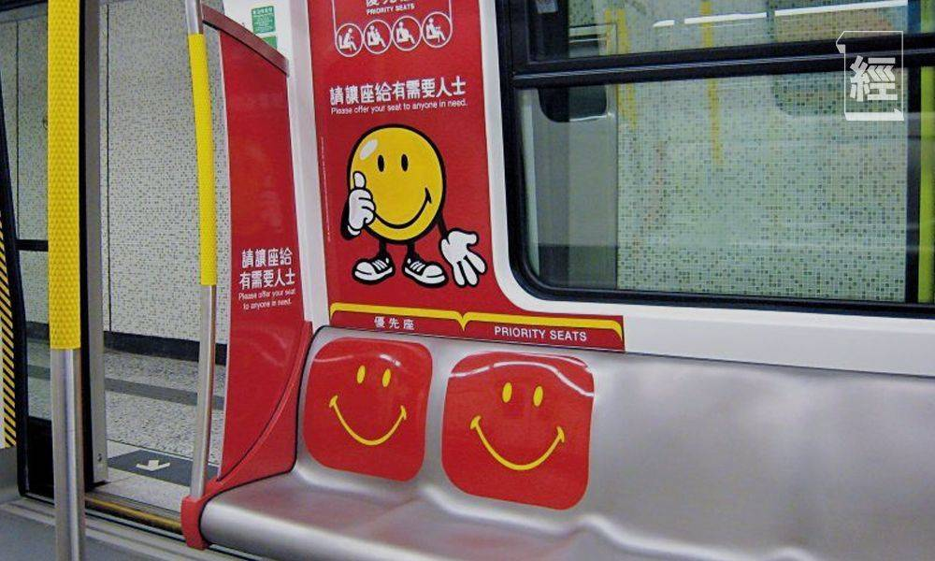
What can we do?
Treat individuals with disabilities with respect and kindness.
Compromise the challenges faced by individuals with physical impairments.
Left the seat for them in public transport.
Offer help when you see someone struggling.
When organizing events or activities, ensure they are accessible to individuals with disabilities.
Discrimination

Slide 16


Conclusion
Discrimination does not aligned with utilitarianism. It is not moral We should respect to disabilities, help them when they are in trouble Create a better community

Slide 17
References
https://www.youtube.com/watch?v=5dKqpqdZuCs
https://soul2.hkuspace.hku.hk/pluginfile.php/6292546/mod_resource/content/1/T3%20rev%201.pdf
https://www.eoc.org.hk/Upload/casebook/book_FA_eng_new_3_3759.pdf

Slide 18



Q&A Section

